Slide 1
Journée agile
Seamus Connolly,Pauline Leroux Eric Mansoux, Ségolène Porot
06/05/2022

Slide 2

Notes:
3 minutes (03) (Eric then Seamus)
Hello we are very happy to be here and, before we introduce ourselves, we have three questions for you: (Eric)
How many of you have worked in an agile environment ? (raise your hands)
How many of you think have achieved self-organisation?
How many of you have achieved benefits of self-organisation?
For us it means… (Seamus)
Why self-organisation?
self-organizing teams is surely one of the popular concepts circulating in agile companies for which there is great confusion and little consensus.
A first part that emphasizes that team members work together, in their own way – as opposed to traditional functioning where someone external to the team (usually a manager) determines one or more of the following: Which team member (the “who”) works on what activities (the “what”) and in what way (the “how”) with a common goal to achieve together decided by the team and even beyond.
As a self-organized we determine by themselves the tasks on which they work without waiting for their superior to give them activities to complete.
It means Manage the estimation, allocation, reassignment and advancement of their work independently with the objective of achieving established goals. Need an engaging vision and support to achieve it through coaching, mentoring and coaching (rather than direction and control) with the goal of continuous improvement. Continuously improve their own skills and recommend innovative ideas and improvements.

Slide 3









AXA Partners
Our mission
Combining passion with advanced expertise,
at AXA Partners we design and deliver worldwide solutions for partners and communities.
We protect what matters, when it matters.
Assistance & Services
Motor – Health - Home
Customer experience
10M
40,000
20,000
€2. 98 bn
+1,000
Credit & LifeStyle Protection
Data analytics
Specialized Insurance
Travel insurance - Consumer electronics -
Legal & digital protection
Operational excellence
Assistance
handled
cases
Medical
Providers*
Motor
Providers**
Strong
Revenues
Partnerships Worldwide
Innovation and technology
We boost our business partners’ customers experience
Banking
Health
Retail
Automotive
Travel
Utilities
Telecoms
Digital
2020 figures * Outside USA (specific network of 890 000 providers) **Motor network footprint: BE,CY,CZ,FR,DE,GR,IE,IT,LU,PL,PT,SK,ES,CH,TR,UK, DZ,MA, CA, MX,CL,AR,BO,CR,DO,EC,SV,GT,HN,PY, PE,PR,TT,UY,PA, CN,HK,MY,PH, TH

Slide 4
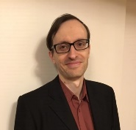
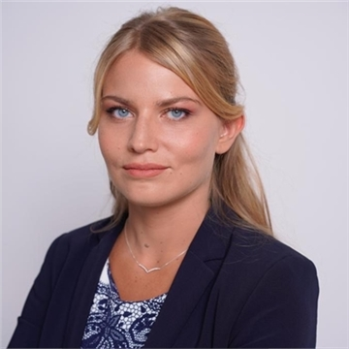
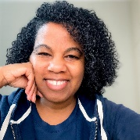
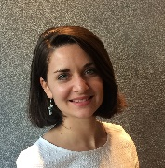
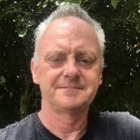
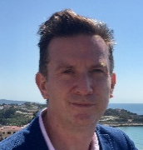
www.axapartners.com
Who are we?
Eric Mansoux
Agile coach
Agile superpower:
Agile at scale, Kanban for Services
Ségolène Porot
Agile coach
Agile superpower:
Product Management, Scrum Mastery
Joselita Diman
Agile Orchestration Lead
Agile superpower:
Team management, cheerleader
AGILE LAB
AGILE ORCHESTRATION
Pauline Leroux
Agile coach
Agile superpower:
Communities of Practice, Agile change management
Seamus Connolly
Agile coach
Agile superpower:
Scrum Mastery, Estimation and planning, Culture and mindset
Martin Mills
Agile consultant/coach
Agile superpower:
Organization Design, Development Practices

Slide 5
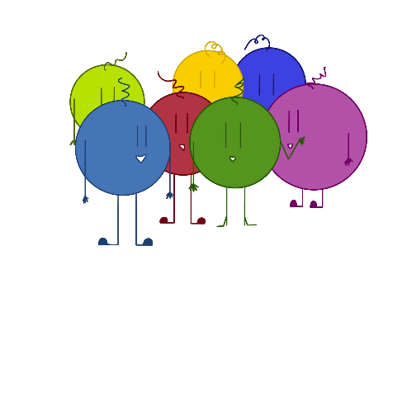
Our challenges?
How to make the right decisions in our transformation context?
How to collaborate with 6 agile coaches in 3 countries?
How to align goals and vision with two different teams in two different department?
How to onboard diverse stakeholders in a multi-countries company?
How to keep growing and improving when our priorities are changing?
Notes:
1 minute (09)
Pauline
According to our topic, we have met some challenges as we are 6 coaches from 2 teams in a multi-country context

Slide 6


Our rituals – What we have experimented with?
Daily
Mini-sprint planning
Weekly review
Weekly role random assignment
Kanban board
Short-term roadmap
Retrospective
Notes:
8 minutes (17)
GIVE QUICK EXPLANATION OF EACH RITUAL
We have experimented several rituals:
The daily is a daily ritual to share in 15min information on progress, next steps and issues between members of the team
The mini-sprint planning is a discussion between members at the beginning of the week to have a mutual understanding of the objective of the week and what they would like to achieve at the end of the week
The weekly review is the discussion at the end the week about things achieved this week, related to the objectives shared during the mini-sprint planning
In liaise with these roles, we have tested the:
Weekly role random assignment. We assign each week, some roles for dailys of the week between the facilitator, the cheerleader, the rules keeper and the mister limits&KPI
During these rituals, we use this tool:
Kanban board is a way to get an overview of your work and make it evolve based on what’s happening on a regular basis
The short-term roadmap is a representation of progress and direction in the future we want to go for 3 coming months
The Retrospective is a regular ritual to exchange about what worked, what did not work and what we can improve in our ways of working
In your opinion, regarding daily, how did it work? And what about the weekly role random assignment?

Slide 7

Our rituals – What we have experimented with?
Daily
Mini-sprint planning
Weekly review
Weekly role random assignment
Kanban board
Short-term roadmap
Retrospective
Notes:
When we show cherry, it means it’s working. The number of cherrys means the value
When we show banana, it means it could be better. The number of banana means the low of value
First of all, the daily meeting with a Kanban board. Obviously it’s working very well. It’s a perfect daily way to collaborate quickly, efficiently and share main challenges or achievements with the team. It’s working very well but we had to adapt regularly ensuring the flow is fluent.
Then the weekly role assignment. After few dailys, we observed that few roles appeared. The facilitator, the cheer-leader, the rules keeper, the limits keeper. Each week, each member is drawing a role and will be assigned of this role during the whole week for the daily. The benefit is just for fun and ensuring that a person is not only doing it

Slide 8

Our rituals – How did it go?
Daily
Mini-sprint planning
Weekly review
Weekly role random assignment
Kanban board
Short-term roadmap
Retrospective
Notes:
Regarding other practices,
The mini-sprint planning is working well but all objectives are not linked with our roadmap and at the end of the week, we achieved things that we didn’t plan or not all.
So it’s linked with the weekly review that work not so well because it’s not always linked with our objecitves.
The Kanban board is working well but we have to adapt it regularly.
The short term roadmap is working well because it’s very helpful for us to see priorities in 3 coming months.
And retrospective, not surprising, it’s always a good discussion to improve our ways of working.

Slide 9
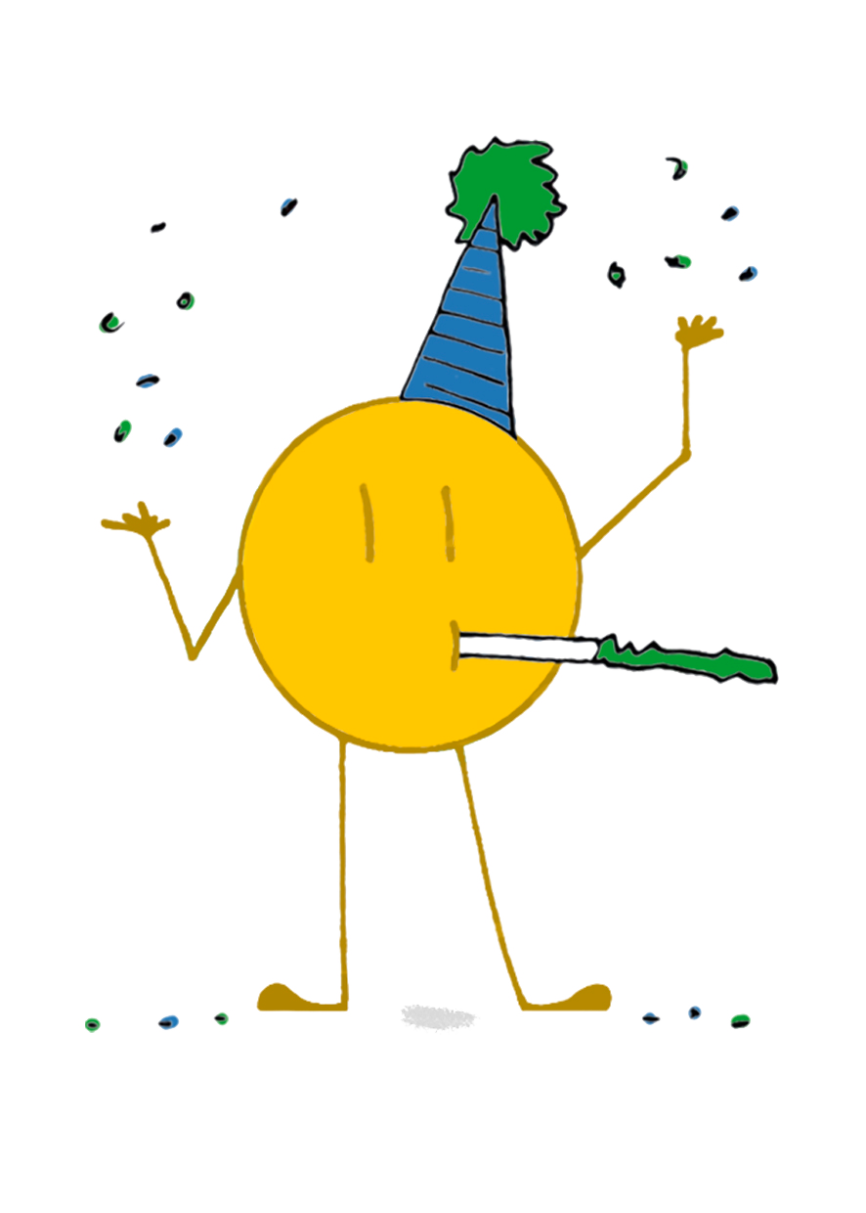

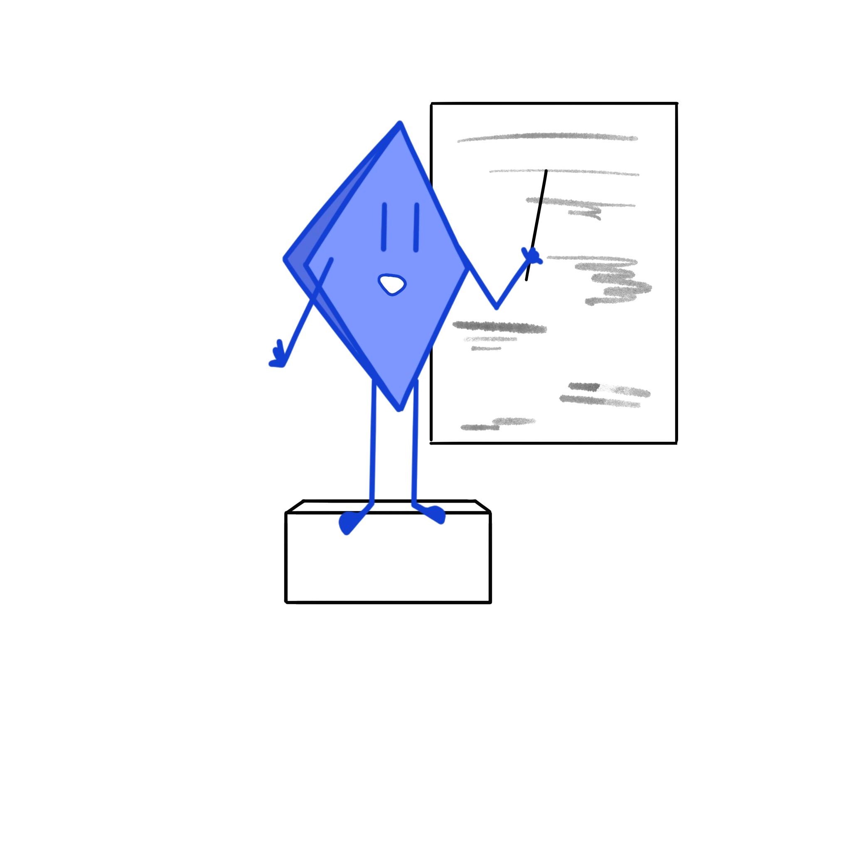

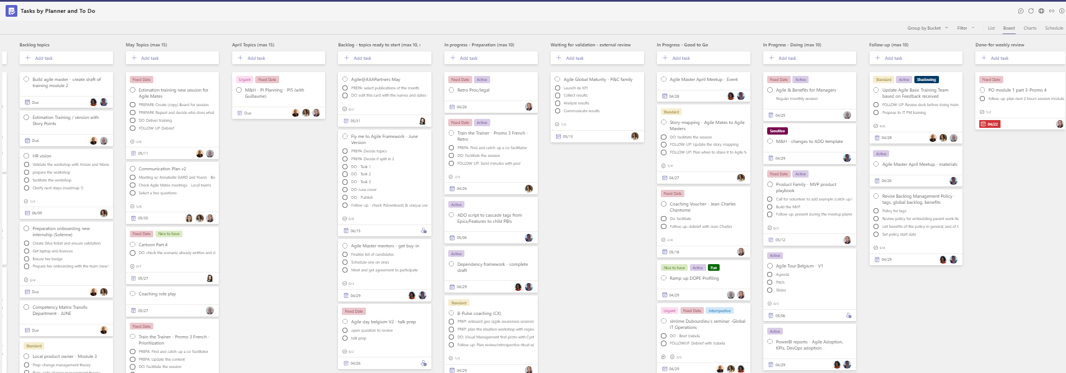
Our rituals – Few examples…
Mr/Ms cheerleader
Mr/Ms Facilitator
Mr/Ms Rules keeper
Mr/Ms Limits & KPI
Weekly roles for the daily
Kanban board in Teams
Notes:
To give you some concrete example, here a screenshot of the Kanban: We moved from 3 columns to 10 because we are always improving it by adding or removing columns according to our flow and ensuring it’s fluent in our ways of working and in our context.
Then I’m pleased to present you our guys with various roles.
To conclude, these rituals are key to meet some challenge and to go further, the empowerment of members in the team is very important

Slide 10
Empowerment - What we have experimented with?
Team decision matrix
Lead coach
Delegation poker

Slide 11
Empowerment - How did it go?
Team decision matrix
Lead coach
Delegation poker

Slide 12
Empowerment - How did it go?
Team decision matrix
Lead coach
Delegation poker

Slide 13
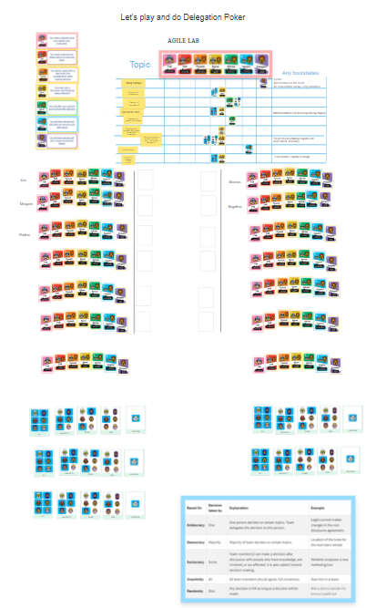
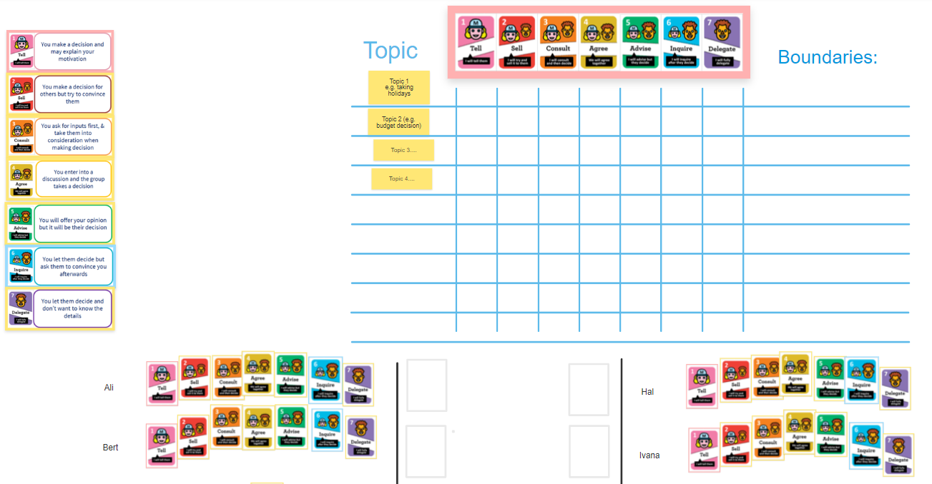
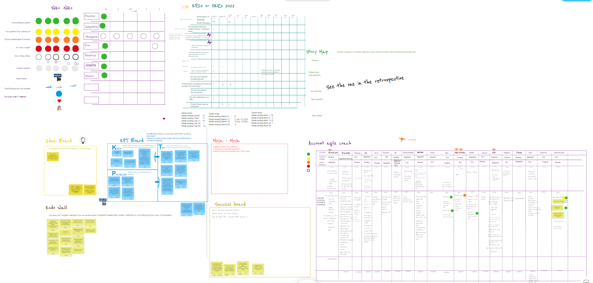
Empowerment - Few examples
Delegation poker
Team decision matrix
Lead coach

Slide 14
Grow & learn – What we have experimented with
Role play
Ramp-up
Coaching delivered in pairs
“Google time”
Notes:
We are continuously looking for ways to improve. What we know and do today is just the current version.
In addition to reading books and articles and taking courses, we look to various practices to help us grow as a team:
Role play is used to get better skill-transfer of practical techniques e.g. coaching tactics
We use ramp-up sessions to skill transfer knowledge from books, courses and experiences
Coaching delivered in pairs benefits both ourselves, picking up good habits from each other but also to improve engagement from our participants
“Google time” was an early experiment in the team to reserve capacity in the week for CPD. We are looking at better ways to do this now.

Slide 15
Grow & learn – How did it go?
Role play
Ramp-up
Coaching delivered in pairs
“Google time”
Notes:
We have not used role play as much as we should perhaps have done so up until now.
Ramp-ups are used more often than the other examples here and are working well for us.
Coaching in pairs is still a preference for us although we do have challenges in availability.
Google time has been mostly superseded by ramp-up sessions.

Slide 16
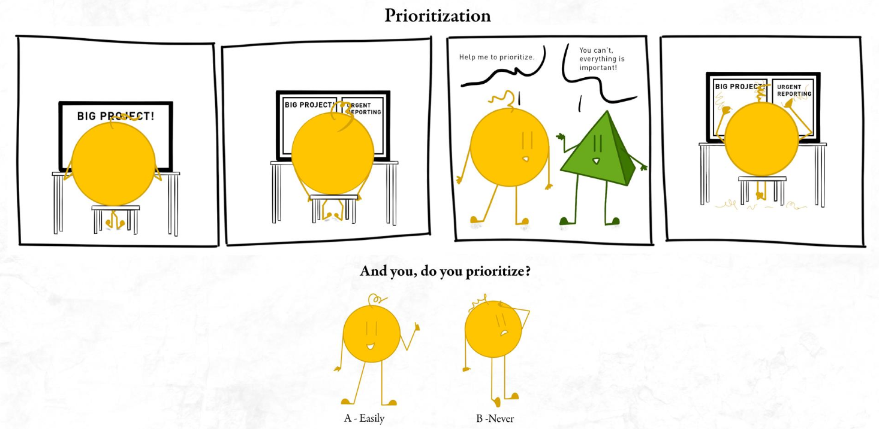
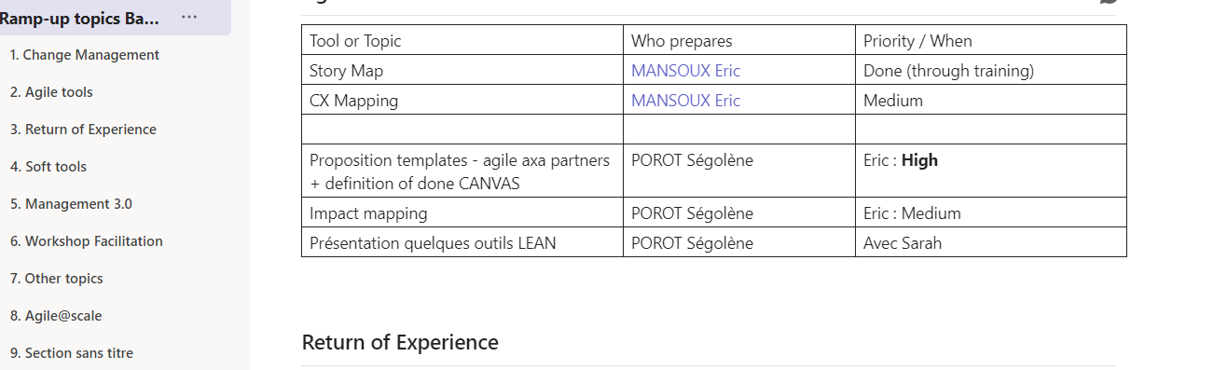
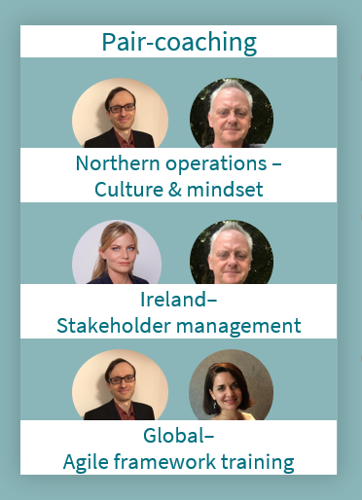
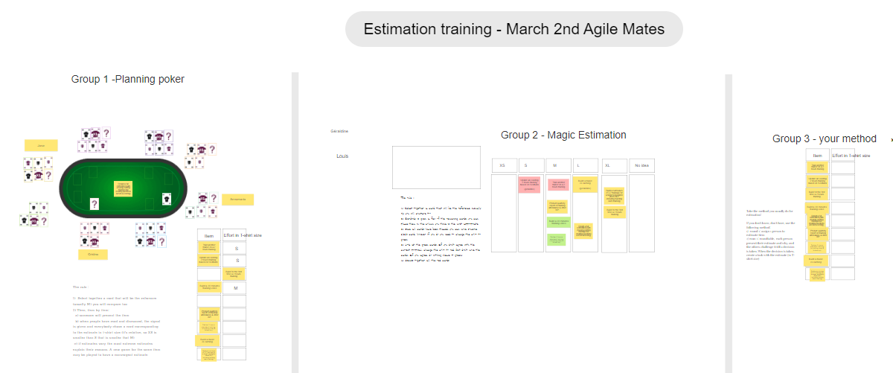
Learn & grow– Few examples…
Cartoons created during Google time
List of Ramp-up sessions
Notes:
Here are some visual examples.

Slide 17
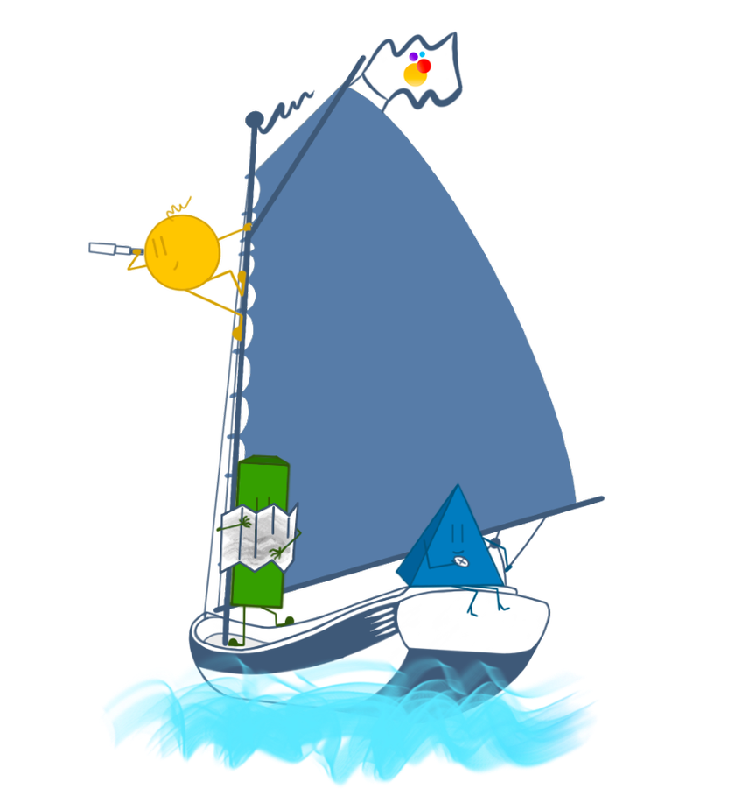
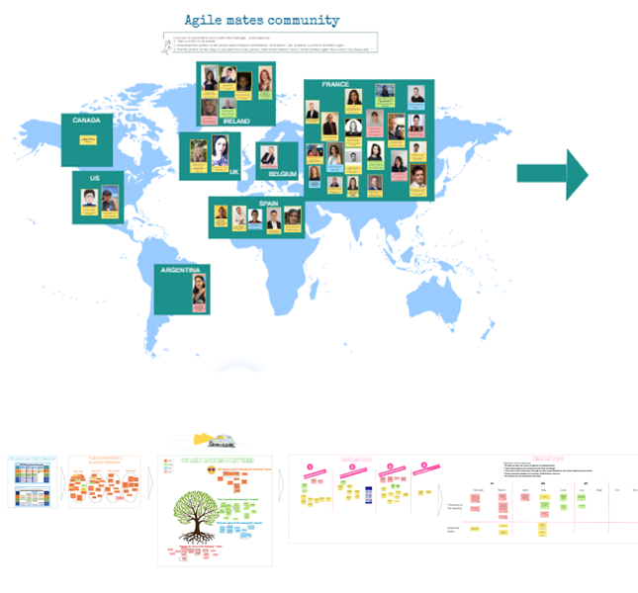
Use relays to scale
TOM Builders’ community
Agile Mates’ community
“Fly me to Agile” framework and associated trainings
Product family community
Facilitation of Seminars

Slide 18
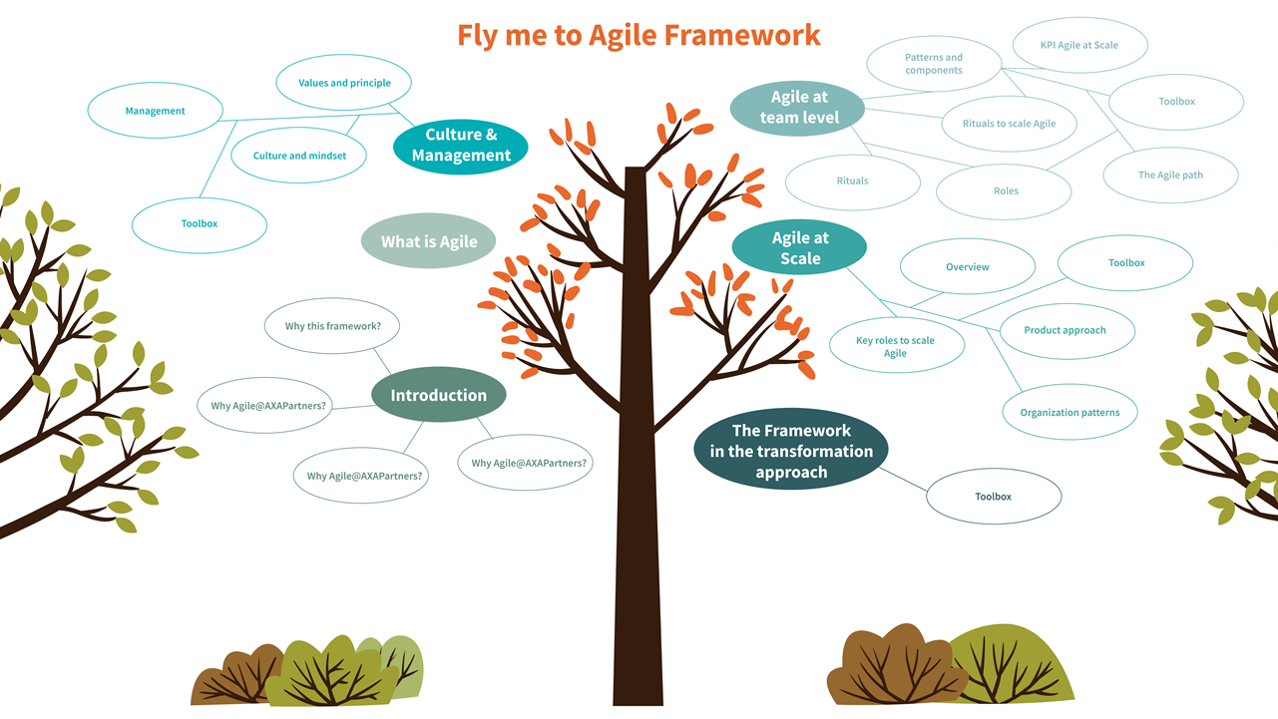
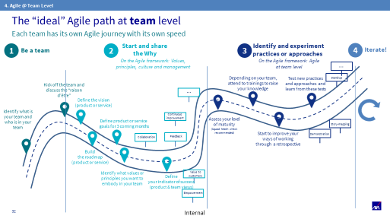
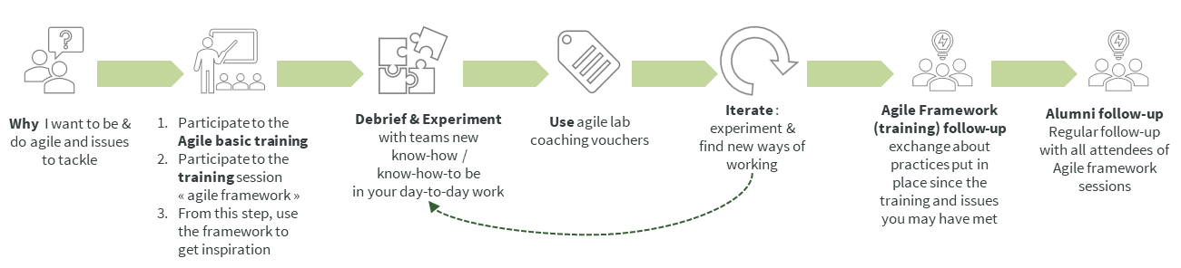
Zoom on the Fly me to agile framework cursus
Fly Me To Agile Framework “cursus”
95 managers trained, ROTI 4.5, 40% used coaching voucher afterwards, >30% implemented agile practices
Fly Me To Agile Framework “cursus”
95 managers trained, ROTI 4.5, 40% used coaching voucher afterwards, >30% implemented agile practices

Slide 19
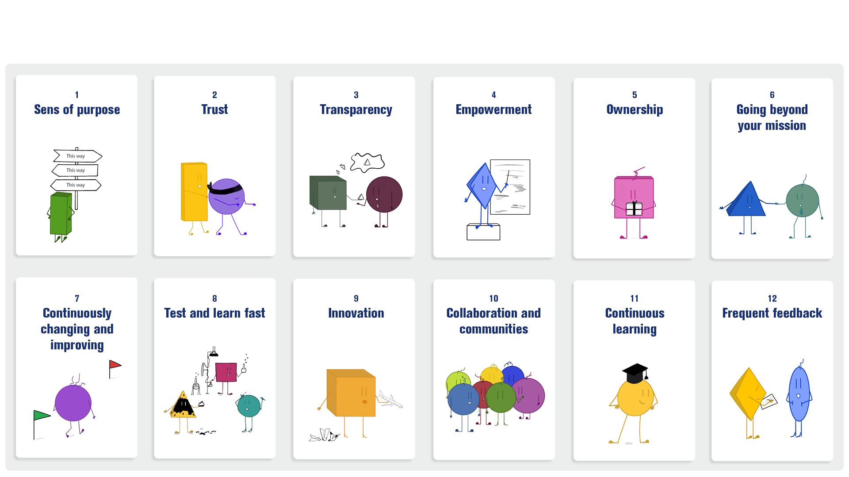
The 12 elements of an « Agile Culture »
Agile culture - English version
Notes:
3 minutes (40)
Pauline
We have experiencing some tools & practices and these tools are only means to achieve this culture based on the 12 elements
We continue our agile journey based on these 12 elements on an agile culture.
If it works in our case, it could work (or not) in yours
In our context, it doesn't replace the agile manifesto → it’s a way to include non-it & IT teams context

Slide 20
Questions and answers

Slide 21
Thank you

